Slide 1

Session Learning Outcome-SLO-4
Types of Maps between Metric spaces

Slide 2

Metric Map
A metric map is a function between metric spaces that does not increase any distance
Such functions are always continuous
These maps are the morphisms (structure-preserving maps) in the category of metric spaces
They are also called Lipschitz functions with Lipschitz constant 1, nonexpansive maps, nonexpanding maps, weak contractions, or short maps.
Suppose that X and Y are metric spaces and ƒ is a function from X to Y
Thus we have a metric map when for any points x and y in X,
where d_{X} and d_{Y} - metrics on X and Y respectively.

Slide 3
Example
Category of metric maps
The composite of metric maps is also metric map, and the identity map id : M → M on a metric space M is a metric map.
Thus metric spaces together with metric maps form a category Met.
Met is a subcategory of the category of metric spaces and Lipschitz functions.
A map ƒ between metric spaces is an isometry if and only if it is a bijective metric map whose inverse is also a metric map.
Thus the isomorphisms in Met are precisely the isometries.

Slide 4
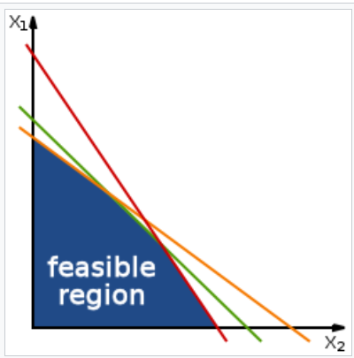
Strictly metric maps
ƒ is strictly metric if the inequality is strict for every two different points
inequality
an inequality is a non-equal comparison between two numbers
It is used to compare two numbers on the number line by their size.
There are several different notations used to represent different
kinds of inequalities:
The notation a < b means that a is less than b.
The notation a > b means that a is greater than b.
In either case, a is not equal to b. These relations are known as
strict inequalities, meaning that a is strictly less than or strictly greater than b.

Slide 5
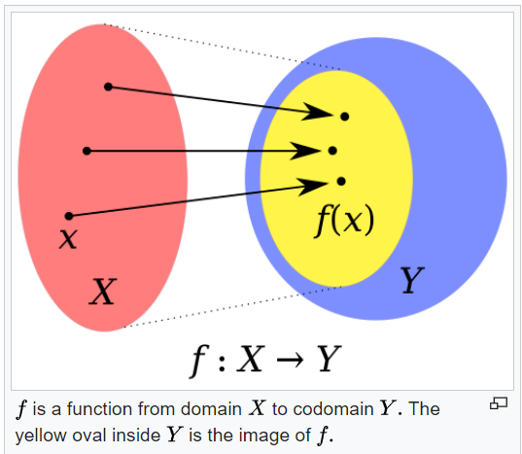
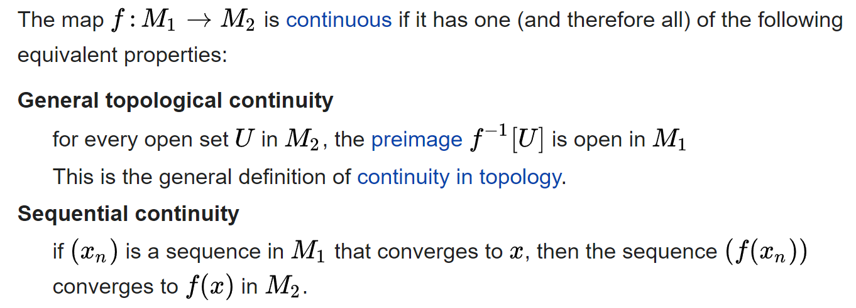
Types of maps between metric spaces

Slide 6
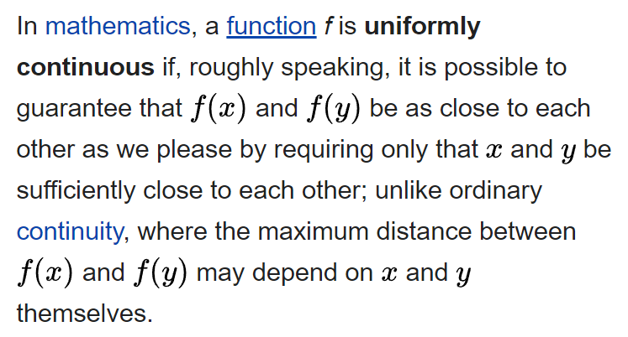
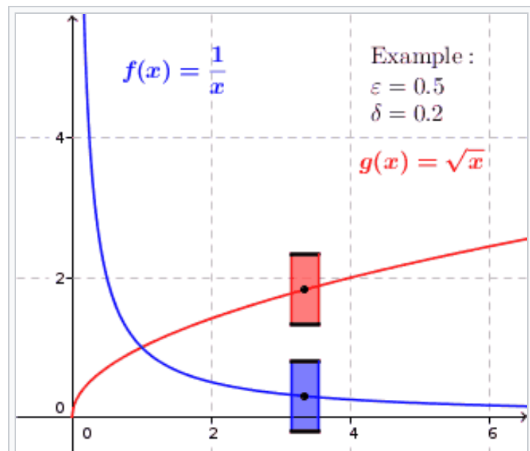
Uniformly Continuous

Slide 7
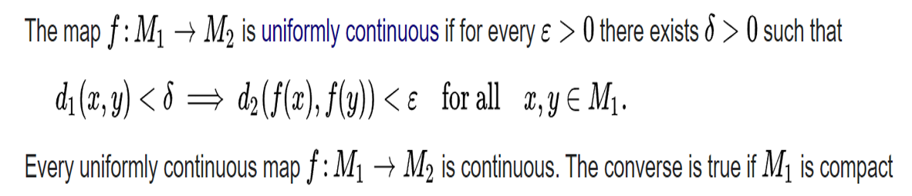
Uniformly continuous maps

Slide 8
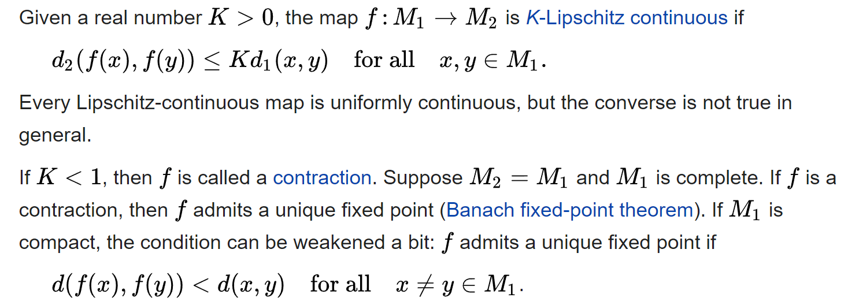
Lipschitz-continuous maps and contractions

Slide 9
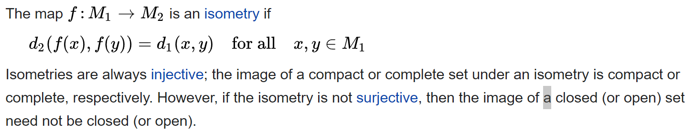
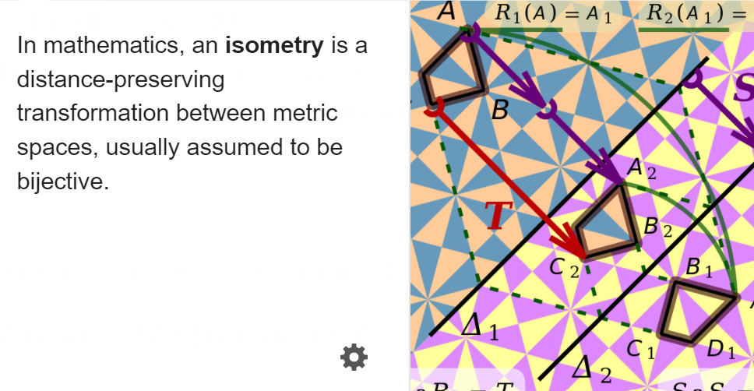
Isometries

Slide 10
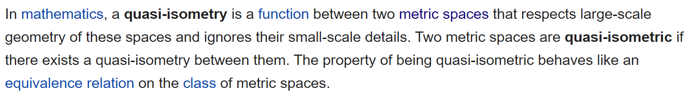
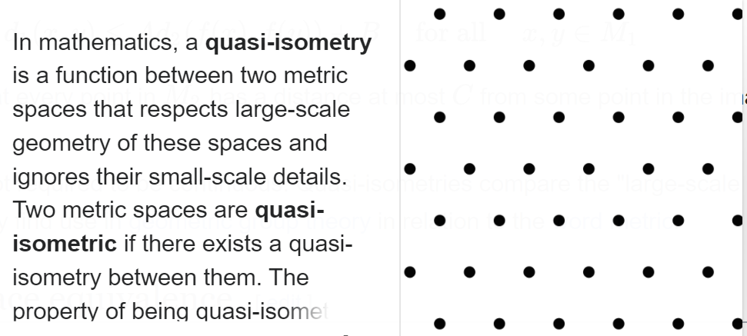
Isometries

